Slide 1
Logical Inference: Through Proof to Truth
CHAPTERS 7, 8
Oliver Schulte
Notes:
Propositional logic.
1st-order logic.
Resolution.
DPLL
WalkSat.
Title alludes to book by Peter Andrews.

Slide 2
Active Field: Automated Deductive Proof
Call for Papers

Slide 3
Proof methods
Proof methods divide into (roughly) two kinds:
  Application of inference rules:
    Legitimate (sound) generation of new sentences from old.
    Resolution
    Forward & Backward chaining (not covered)
  Model checking
    Searching through truth assignments.
    Improved backtracking: Davis--Putnam-Logemann-Loveland (DPLL)
    Heuristic search in model space: Walksat.

Slide 4
Proof Methods Overview
Methods
generate new sentences from given sentences
search through truth assignments
most useful if we expect no solution to exist
most useful if we expect a solution to exist
Inference Rules
Model Checking
Forward/Backward Chaining
DPLL
WalkSat
Resolution
improved depth-first search
heuristic probabilistic search
Proof by Contradiction
not covered

Slide 5
Satisfiability problems
Consider a CNF sentence, e.g.,
(¬D ∨ ¬B ∨ C) ∧ (B ∨ ¬A ∨ ¬C) ∧ (¬C ∨ ¬B ∨ E) ∧ (E ∨ ¬D ∨ B) ∧ (B ∨ E ∨ ¬C)
  Satisfiability: Is there a model consistent with this sentence?
  [A ∨ B] ∧ [¬B ∨ ¬C] ∧ [A ∨ C] ∧ [¬D] ∧ [¬D ∨ ¬A]
The basic NP-hard problem (Cook’s theorem).
Many practically important problems can be represented this way. SAT Competition page.
Notes:
By the CNF theorem, all formulas can be written as a CNF sentence.

Slide 6
Exercise: Satisfiability
  Is the following sentence satisfiable?
  [A ∨ B] ∧ [¬B ∨ ¬C] ∧ [A ∨ C] ∧ [¬D] ∧ [¬D ∨ ¬A]

Slide 7
Validity and satisfiability
A sentence is valid if it is true in all models.
  e.g., True, A ∨¬A, A ⇒ A, (A ∧ (A ⇒ B)) ⇒ B (tautologies)
Validity is connected to entailment via the
Deduction Theorem: KB ╞ α if and only if (KB ⇒ α) is valid
A sentence is satisfiable if it is true in some model.
  e.g., A∨ B, C are satisfiable
A sentence is unsatisfiable if it is false in all models.
  e.g., A∧¬A.
Satisfiability is connected to entailment via the following:
  KB ╞ α if and only if (KB ∧¬α) is unsatisfiable
  There is no model for which KB=true and α is false.
  Aka proof by contradiction: assume α to be false and this leads to contradictions with KB.
Notes:
Demo using tarki’s world. Take the entailment A & B => A or B.

Slide 8
Resolution: Spot the Pattern
Premise 1 | Premise 2 | Conclusion
A ∨ B ∨ C | ¬A | B ∨ C
A ∨ B | ¬A ∨ B | B
A ∨ B ∨ C | ¬A ∨ D ∨ E | B ∨ C ∨ D ∨ E
What is the rule to get from the two premises to the conclusion?
Notes:
pattern: cancel out common negated literal.

Slide 9
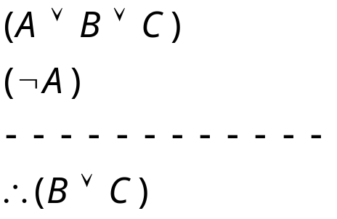
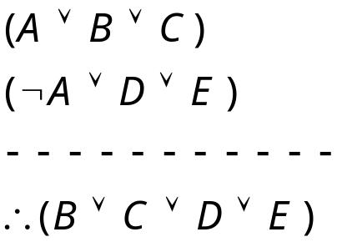
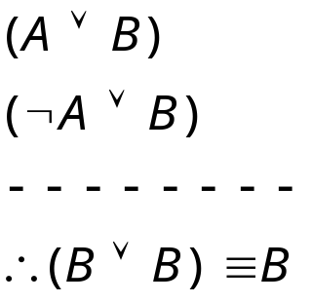
Resolution Inference Rule for CNF
“If A or B or C is true, but not A, then B or C must be true.”
“If A is false then B or C must be true,
or if A is true then D or E must be true, hence since A is either true or false, B or C or D or E must be true.”
Generalizes Modus Ponens: from
A implies B, and A, infer
B. (How?)
Simplification
Notes:
Can rewrite as A ->
Not A ->
Disjoin the consequents.

Slide 10
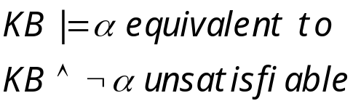

Resolution Algorithm
The resolution algorithm tries to prove:
Generate all new sentences from KB and the query.
One of two things can happen:
We find which is unsatisfiable,
i.e. the entailment is proven.
2. We find no contradiction: there is a model that satisfies the
  Sentence. The entailment is disproven.

Slide 11

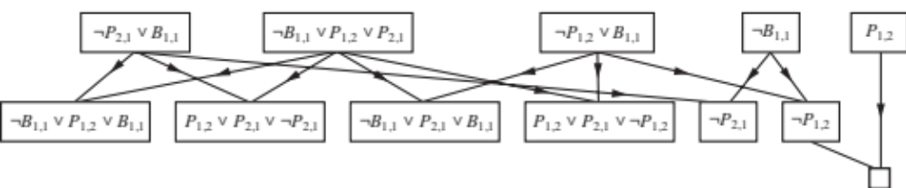
Resolution example
KB = (B_{1,1} ⇔ (P_{1,2}∨ P_{2,1})) ∧¬ B_{1,1}
α = ¬P_{1,2}
True
False in
all worlds

Slide 12
More on Resolution
Resolution is complete for propositional logic.
Resolution in general can take up exponential space and time. (Hard proof!)
If all clauses are Horn clauses, then resolution is linear in space and time.
Main method for the SAT problem: is a CNF formula satisfiable?
Typically most useful when we expect the formula to be unsatisfiable.
Notes:
Single inference rule is complete!

Slide 13
Model Checking
Two families of efficient algorithms:
Complete backtracking search algorithms: DPLL algorithm.
Incomplete local search algorithms.
  WalkSAT algorithm
If search returns failure (after some number of tries) we cannot tell whether the sentence is unsatisfiable or whether we have not searched long enough.
Typically most useful when we expect the formula to be satisfiable.

Slide 14
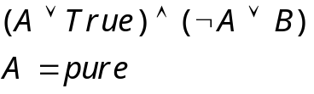
The DPLL algorithm
Determine if an input propositional logic sentence (in CNF) is
satisfiable. This is just like backtracking search for a CSP.
Improvements:
  Early termination
    A clause is true if any literal is true.
    A sentence is false if any clause is false.
  Pure symbol heuristic
    Pure symbol: always appears with the same "sign" in all clauses.
    e.g., In the three clauses (A ∨ ¬B), (¬B ∨ ¬C), (C ∨ A), A and B are pure, C is impure.
    Make a pure symbol literal true.
    (if there is a model for S, then making a pure symbol true is also a model).
  3 Unit clause heuristic
    Unit clause: only one literal in the clause
    The only literal in a unit clause must be true.
    In practice, takes 80% of proof time.
    Note: literals can become a pure symbol or a
    unit clause when other literals obtain truth values. e.g.

Slide 15
The WalkSAT algorithm
Incomplete, local search algorithm
  Begin with a random assignment of values to symbols
  Each iteration: pick an unsatisfied clause
    Flip the symbol that maximizes number of satisfied clauses, OR
    Flip a symbol in the clause randomly
Trades-off greediness and randomness
Many variations of this idea

Slide 16
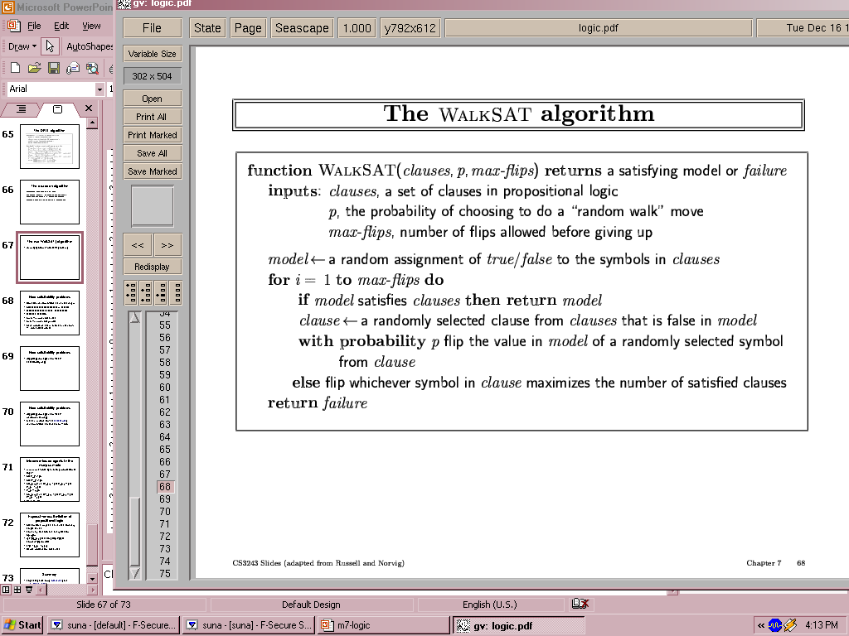
Pseudocode for WalkSAT

Slide 17
Hard satisfiability problems
Consider random 3-CNF sentences. e.g.,
(¬D ∨ ¬B ∨ C) ∧ (B ∨ ¬A ∨ ¬C) ∧ (¬C ∨ ¬B ∨ E) ∧ (E ∨ ¬D ∨ B) ∧ (B ∨ E ∨ ¬C)
  m = number of clauses (5)
  n = number of symbols (5)
  Underconstrained problems:
    Relatively few clauses constraining the variables
    Tend to be easy
    16 of 32 possible assignments above are solutions
      (so 2 random guesses will work on average)

Slide 18
Hard satisfiability problems
What makes a problem hard?
  Increase the number of clauses while keeping the number of symbols fixed
  Problem is more constrained, fewer solutions
  Investigate experimentally….

Slide 19
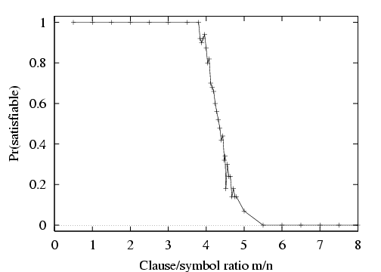
P(satisfiable) for random 3-CNF sentences, n = 50

Slide 20
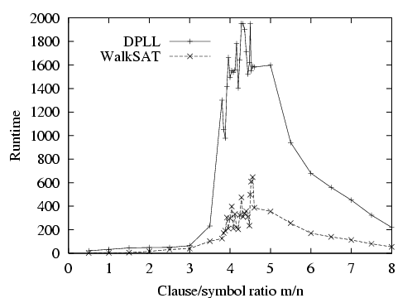
Run-time for DPLL and WalkSAT
Median runtime for 100 satisfiable random 3-CNF sentences, n = 50

Slide 21
Inference-based agents in the wumpus world
A wumpus-world agent using propositional logic:
  ¬P_{1,1} (no pit in square [1,1])
  ¬W_{1,1} (no Wumpus in square [1,1])
  B_{x,y} ⇔ (P_{x,y+1} ∨ P_{x,y-1} ∨ P_{x+1,y} ∨ P_{x-1,y}) (Breeze next to Pit)
  S_{x,y} ⇔ (W_{x,y+1} ∨ W_{x,y-1} ∨ W_{x+1,y} ∨ W_{x-1,y}) (stench next to Wumpus)
  W_{1,1} ∨ W_{1,2} ∨ … ∨ W_{4,4} (at least 1 Wumpus)
  ¬W_{1,1} ∨ ¬W_{1,2} (at most 1 Wumpus)
  ¬W_{1,1} ∨ ¬W_{8,9}
  …
⇒ 64 distinct proposition symbols, 155 sentences

Slide 22
Limited expressiveness of propositional logic
KB contains "physics" sentences for every single square
For every time t and every location [x,y],
L_{x,y} ∧ FacingRight^{t} ∧ Forward^{t} ⇒ L_{x+1,y}
Rapid proliferation of clauses.
First order logic is designed to deal with this through the
introduction of variables.

Slide 23
Summary
Determining the satisfiability of a CNF formula is the basic problem of propositional logic (and of many reasoning/scheduling problems).
Resolution is complete for propositional logic.
Can use search methods + inference (e.g. unit propagation): DPLL.
Can also use stochastic local search methods: WALKSAT.

